Slide 1
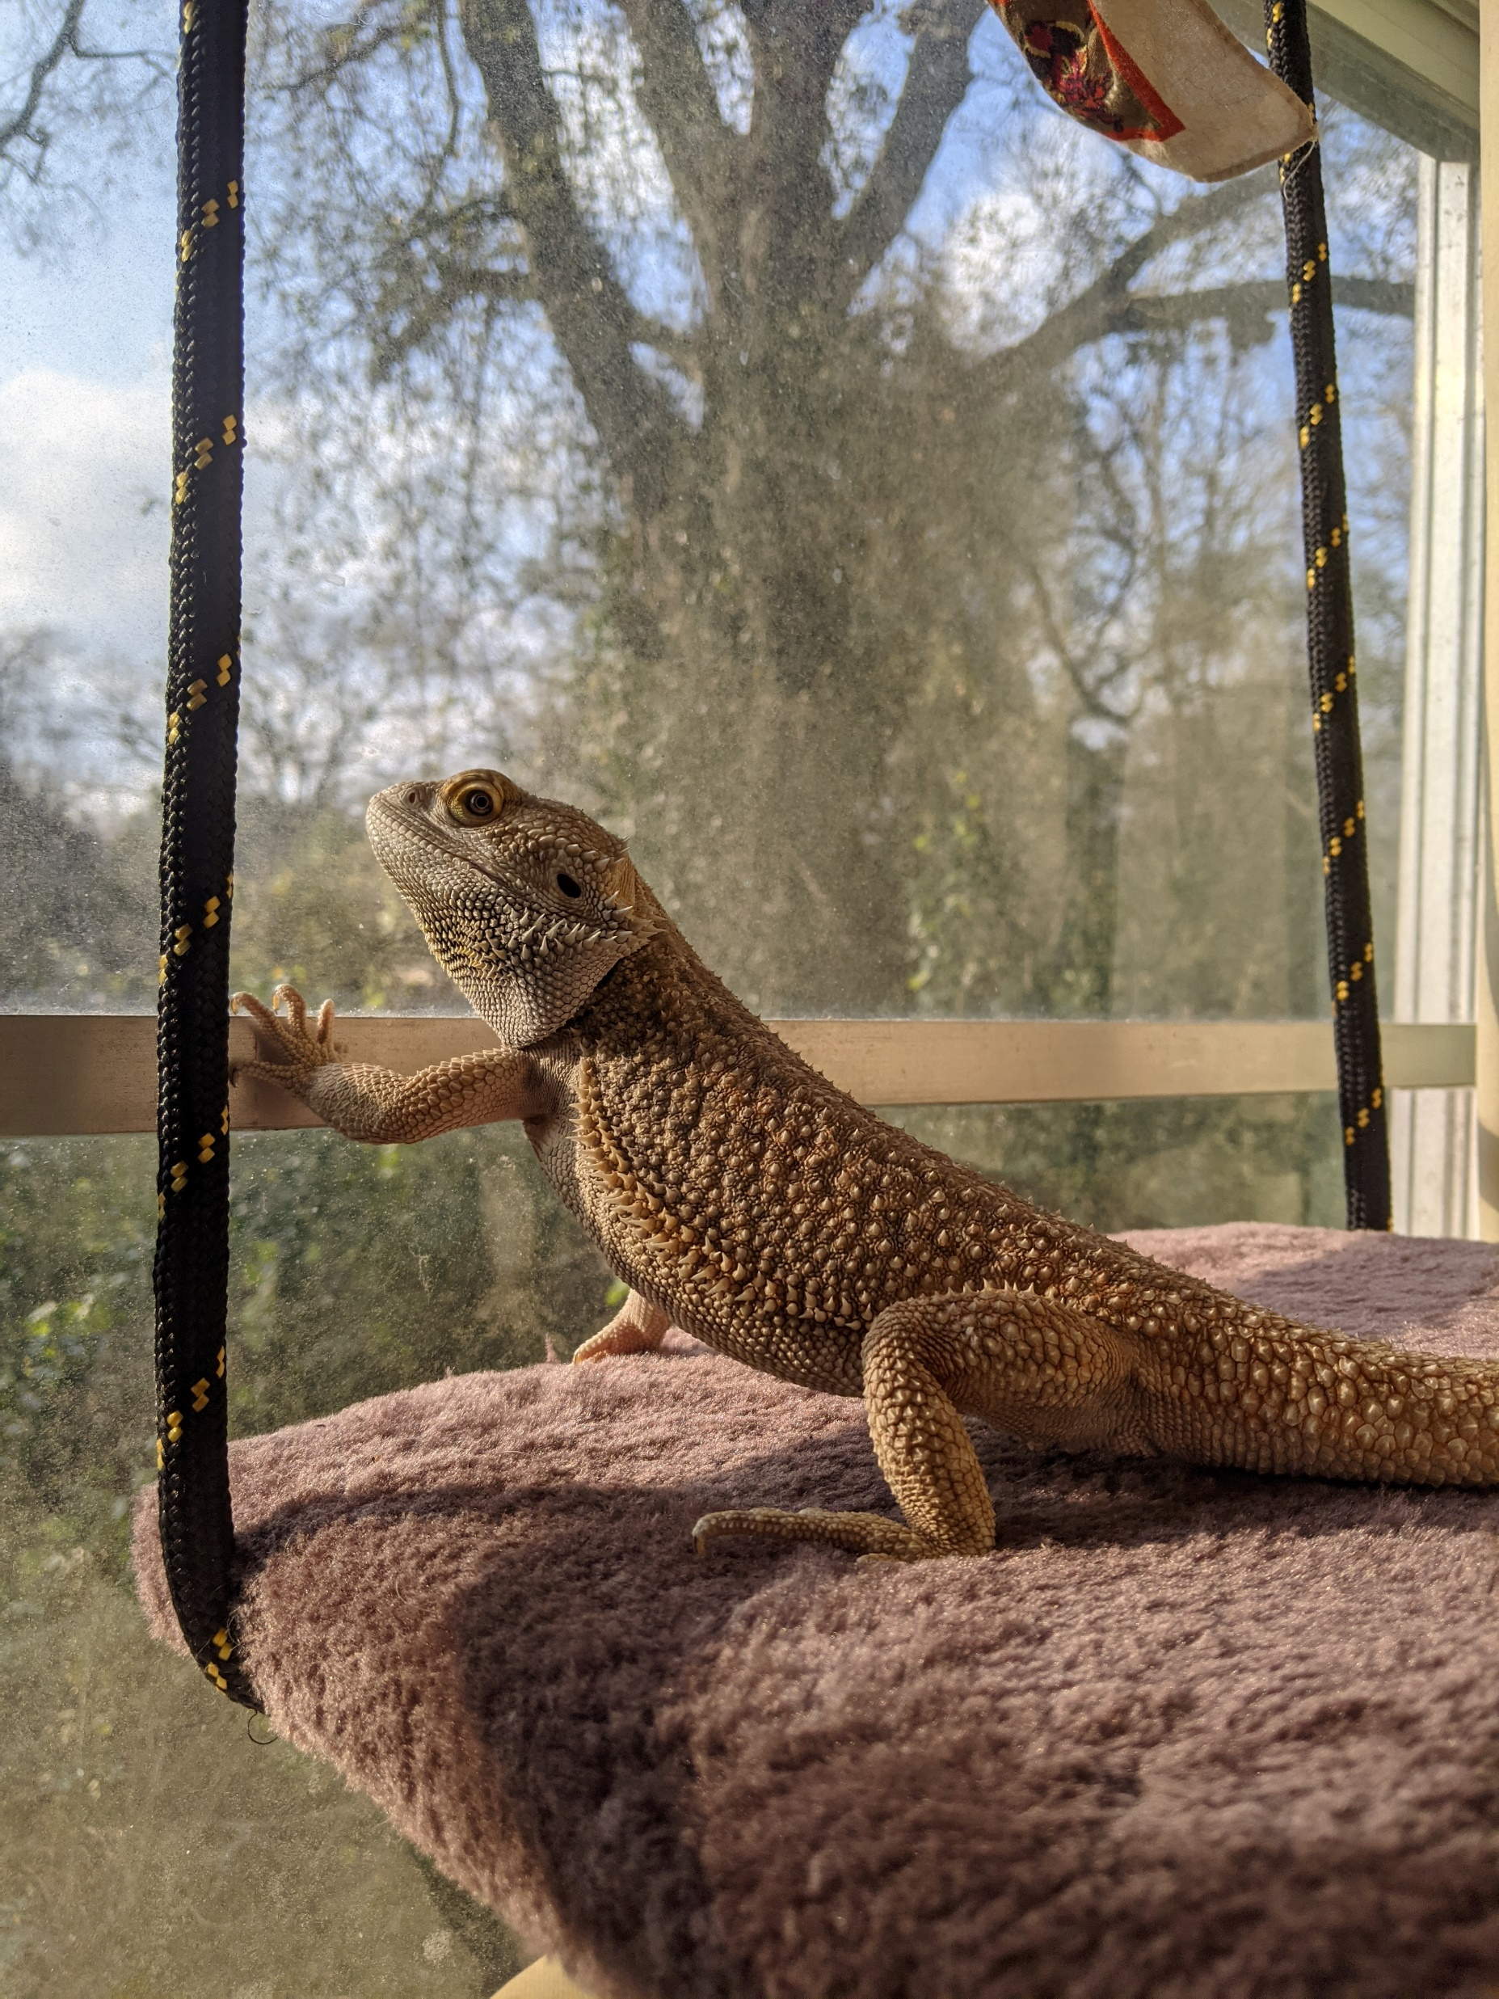

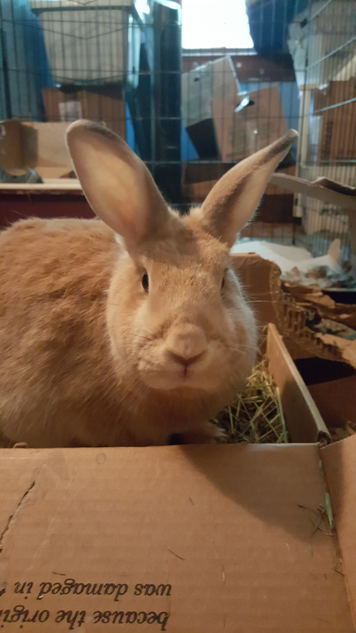

R Lab Week 6: Linear Models
Severus
Bearded Dragon
←
Roxy
Short version: Border Collie + Lab Mix
→
L Burleigh
9/30/2022
Add to our playlist:
Miss Moo ^
Breed guess: New Zealand Red rabbit

Slide 2
Lab Objectives
Investigate ANOVA options in R
Further address column types
Setting/checking contrasts
Box plots

Slide 3
Potentially vague terms
Level - the groups in a factor of an ANOVA
Factor (ANOVA) - the overall topic of directly related groups
Factor (R) – a type of column in a data frame which is specifically coded to denote groups where the column is a factor in an ANOVA
E.g., pop, punk, and metal are each a level of the music factor

Slide 4
Helpful Code
Task | Code
Check the contrasts on column a in data frame d | contrasts(d$a)
Set column a in data frame d to a factor, changing values 1, 2, and 3 to low, medium, and high | factor(d$a, levels = c(1, 2, 3), labels = c(“low”, “medium”, “high”))

